Slide 1

FilmJet Web Application
A comprehensive platform designed to revolutionize film & TV streaming with personalized and community-driven experiences.
by Aryan Soni

Slide 2
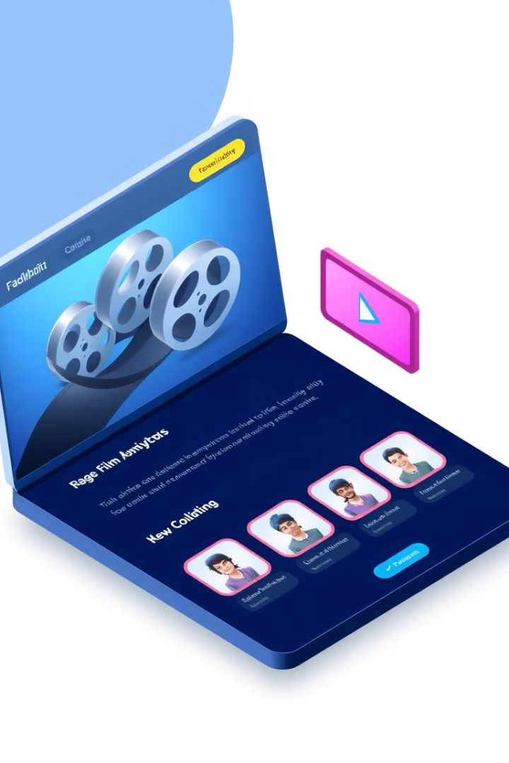
Project Overview
Dynamic Web Platform
Seamless Experience
Explore, stream, and engage with films and TV shows
Delivers personalized recommendations
Community Features
Interaction among film and TV enthusiasts

Slide 3
Problem Statement
Lack of Personalization
Weak Community Engagement
Need for Interaction
Traditional platforms lack tailored recommendations.
Limited interaction and community features
Film enthusiasts seek interaction and discovery

Slide 4

Objectives
1
Seamless Streaming
2
Personalized Content
Provide high-quality, uninterrupted playback
Offer tailored recommendations to each user
3
Foster Community
Encourage interaction through ratings and reviews

Slide 5




Target Audience
Film Enthusiasts
Casual viewers and cinephiles alike
TV Series Lovers
Users who enjoy binge-watching shows
Social Seekers
Users who want to share and interact

Slide 6
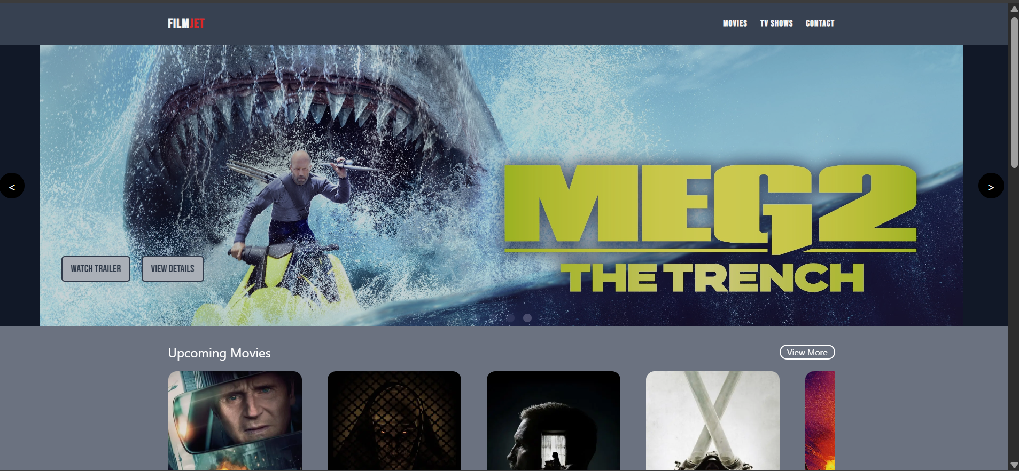




Key Features
Vast Content Library
Extensive collection of films and TV shows
Personalized Recommendations
Tailored content suggestions for users
HD & 4K Streaming
High-quality video support
Ratings & Reviews
User-generated content and feedback

Slide 7
Streaming Experience
HD and 4K Video
1
Superior visual quality
Adaptive Streaming
2
Adjusts based on internet speed
High-Quality Audio
3
Immersive sound experience

Slide 8




Personalized Recommendations
Viewing History
1
Genre-Based
Tracks user activity
2
Suggests similar genres
Preferences
4
Trending Content
3
Content based on past selections
Highlights popular films

Slide 9



Ratings & Reviews
1
User Ratings
2
Detailed Reviews
3
Informed Decisions

Slide 10

Key Takeaways
90%
2X
80%
User Satisfaction
Engagement
Recommendation Accuracy
Projected satisfaction rating
Expected increase in engagement
Higher precision in recs

Slide 11
Project Timeline
Frontend
Backend
Database
React.js / Vue.js
Node.js / Django
MySQL / MongoDB
Responsive Design
Scalability & Performance
User Data Management
Efficient Content Handl

Slide 12
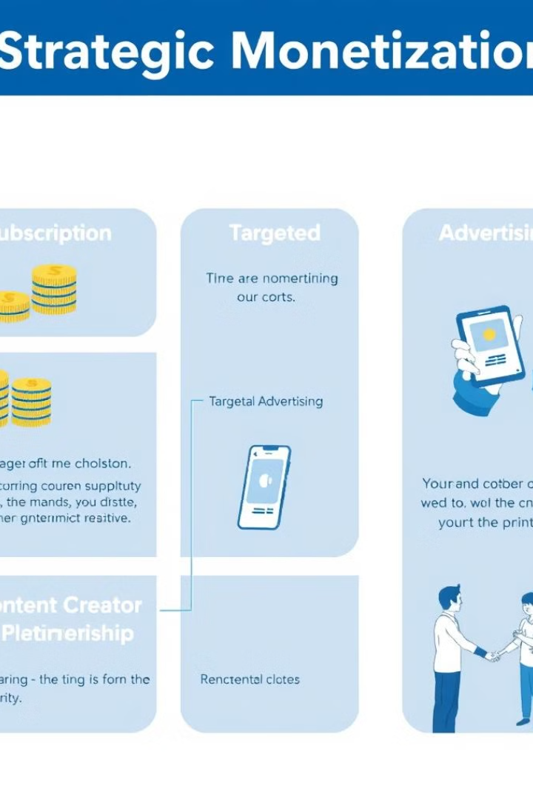



Strategic Monetization
Subscription Plans
Ad Revenue
Partnerships
Offer tiered access with FilmJet Plus for exclusive content and features.
Utilize targeted ads during free content to generate revenue.
Collaborate with content creators to expand library and reach new audiences.

Slide 13
Project Timeline
Phase 1
1
Requirements & Design (2 weeks)
2
Phase 2
Core Features (6-8 weeks)
Phase 3
3
Testing and QA (3 weeks)
4
Phase 4
Support & Updates (Ongoing)

Slide 14
Conclusion
FilmJet offers a comprehensive solution for film and TV lovers to discover, stream, and engage with content.
With personalized features, high-quality streaming, and community interaction, FilmJet is set to redefine the streaming experience.

Slide 15



Contact & Links
GitHub:-https://github.com/officialaryansoni/Filmjet?tab=readme-ov-file
LinkedIn:-https://www.linkedin.com/in/aryan-soni-557b53214/
Email:- Aryan_237701@saitm.ac.in

